Slide 1
10 Tips & Principles for Design
CREATED BY JARED BROWN BASED ON MICROSOFT’S DESIGN ARTICLE

Slide 2
Principle #1: Spacing
Spacing between items or objects on a page separates functions and fields and adds a sense of order.
Correct spacing will also allow for the optimal use of space on the page, preventing an excess of unused space or a lack of natural space.

Slide 3
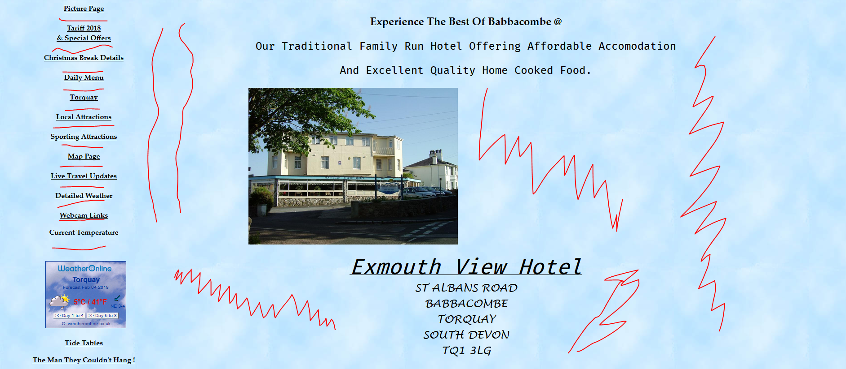
Spacing Example
Note the excessive space between elements highlighted by red lines, this spreads the page out too much, making it hard do quickly skim the page.

Slide 4
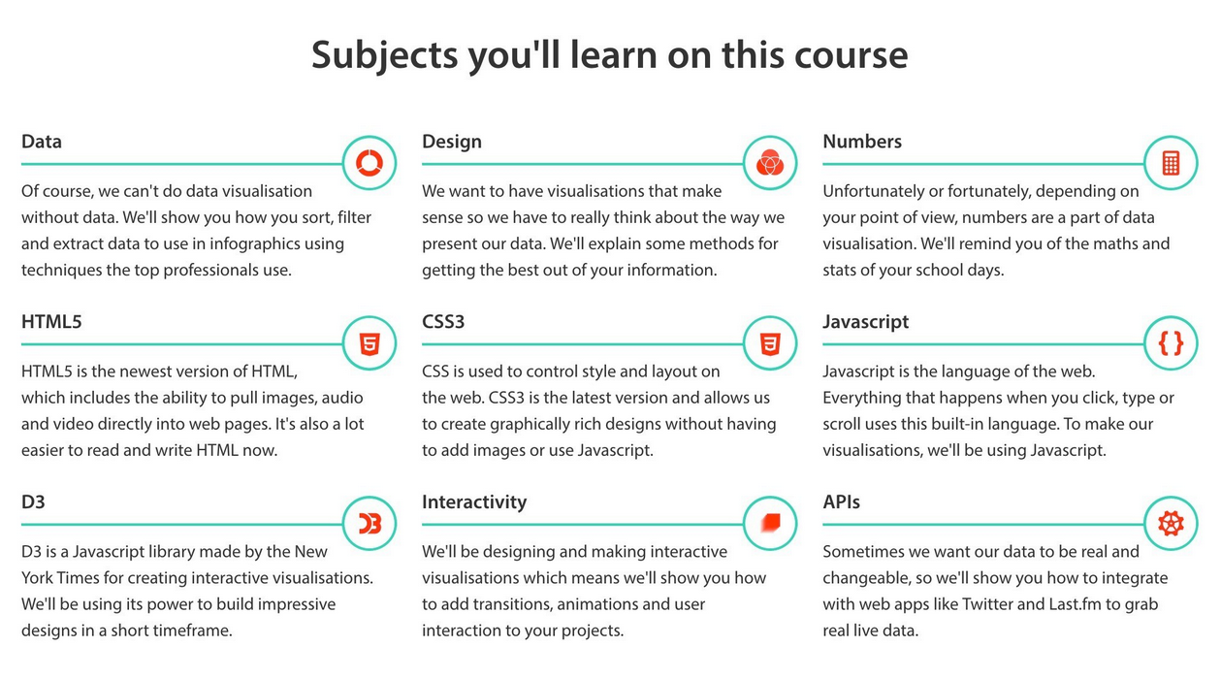
Spacing Example
This is a beautiful example of perfect spacing. It is not too crowded and not too spread out. Spacing between elements should always be consistent.

Slide 5
Principle #2: Size
The size of elements is important as overly large elements take up too much space, while elements which are too small are hard to read or hard to click.
The consistency of the size of elements is also important. Having different sized elements (of the same type) makes the page or application look chaotic. Consider creating standard sizes for element types and stick to them.

Slide 6
Size Example
Click Me!
Too Big ---->
Too Small ->
Click Me!
Just Right ->
Click Me!

Slide 7
Principle #3: Grouping
Grouping is an important part of design. Grouping describes the action of collecting elements together and setting them aside from other elements. There are many ways to group elements together, these are called grouping controls. They can include tabs, menu systems, a table row or column, and more.
You should group things that belong together. Grouped items should all share a similar relationship to one another, and there should not be a hierarchy between items (unless it is a group control containing groups).

Slide 8
Principle #4: Intuitiveness
Creating an intuitive design is important, and the best way to create an intuitive design is to follow common standards in design so that the user has an expectation of what to expect from each control or feature. If your design does stray from common practices, you should aid the user by including other common design considerations like color which can point to severity of an action.
You should also be clear and concise in your wording for options or descriptions so that users without a lot of experience can still understand what each feature does.

Slide 9
6 Tips for A better Design

Slide 10
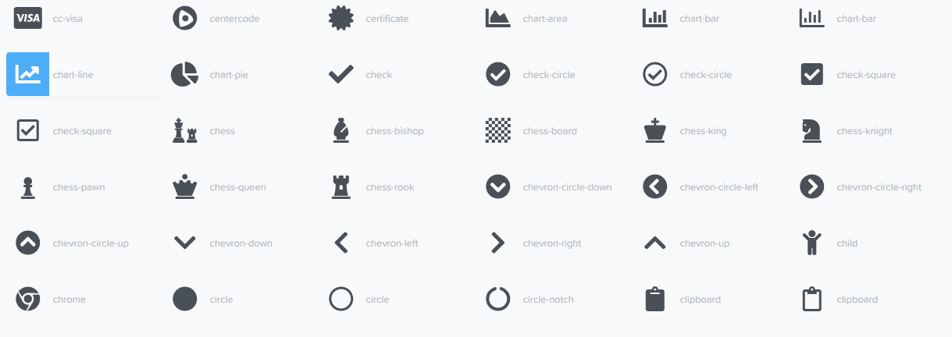
Tip #1: Simplify Recognition with Icons
Icons are oftentimes universal. They describe an action or feature. A “X” means exit, a straight line positioned towards the bottom means minimize to task bar, a cog represents settings. Adding these to your program can help users understand what an element does. These can also help those who do not know the language the page is written in.
Font Awesome Icons

Slide 11
Tip #2: Never Disrupt the User
Disrupting the user annoys the user and makes them less likely to use your site or application. Things like pop-up boxes can get in the way of the user filling out a form or reading an article. Instead, use unobtrusive ways of notifying users like ribbons which do not obstruct the view of the user.

Slide 12
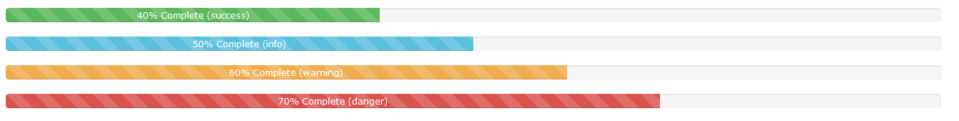
Tip #3:Provide Progress Status
Providing progress status notifies the user that the computer is working on a task or problem and is not just frozen. Also try to provide a description of what is happening while the user waits.
Bootstrap Progress Bars

Slide 13
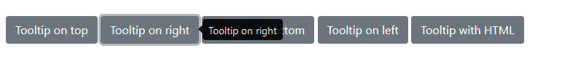
Tip #4:Provide Tool Tips
Providing tool tips give additional information to users about the function of a specific element. This can come in handy for users who are new to your site or program. They should be short and simple but still explain the purpose of the feature.
Bootstrap Tool Tip

Slide 14
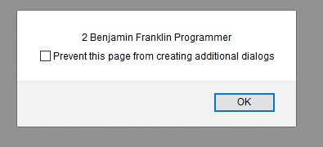
Tip #5:Give a notification Choice
Allow the user to choose whether they want to receive a notification if the notification is a common one. This prevents notification oversaturation which may cause the user to ignore future notification, even if they are important.
Suppress Dialog Feature in FireFox

Slide 15
Tip #6:Simplify Navigation with Breadcrumb Controls and Sidebars
Breadcrumbs and sidebars allow user to navigate to other pages quickly using elements within their view. Using sidebars or breadcrumbs and simplifies navigation by providing structured context which informs the user as to what page they are on, what page they were last on, and what page they can go to next.
Breadcrumb using Bootstrap

Slide 16
TIPs & Principles from Microsoft
Photo Sources
http://www.exmouth-view.co.uk/
http://ui-patterns.com/users/1/collections/lists/screenshots/16480
https://fontawesome.com/icons?d=listing&m=free
https://www.w3schools.com/bootstrap/bootstrap_progressbars.asp
https://getbootstrap.com/docs/4.0/components/tooltips/
https://getbootstrap.com/docs/4.0/components/breadcrumb/
https://msdn.microsoft.com/en-us/library/windows/desktop/ff728831(v=vs.85).aspx

